Slide 1
http://www.advancemovement.com/planting/planting-news/
Advance Quarterly Prayer Points
Thank you so much for being willing to partner with us in praying regularly for items affecting those within the Advance movement. Please feel free to circulate these prayer points to your leaders, church community and prayer groups.

Slide 2
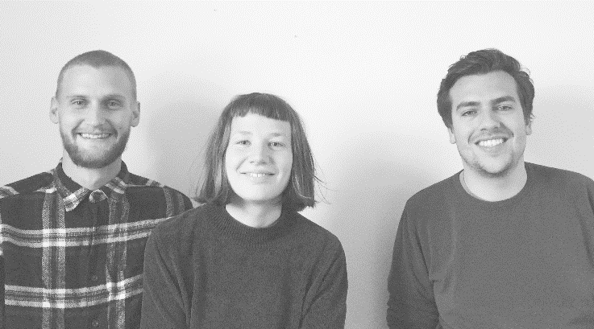
EUROPE:
Liam and Holly Brannigan, along with Tom Beaumont, are spearheading a church plant in Falmouth – birthed by Grace Church in Truro. Over the past two years, they've had a couple of mid-week groups meeting in people's homes in Falmouth. Subsequently, Liam and Holly have seen these groups grow, and are taking steps towards the launch of a new congregation.
Please join them in praying for: 1. Wisdom in knowing when and how to launch the new congregation in Falmouth;
2. Health, spiritual vigour and increased capacity in the leaders as they go through the challenges of significant life changes;
3. Many people to come to faith through the witness of members of the Falmouth church planting team..

Slide 3
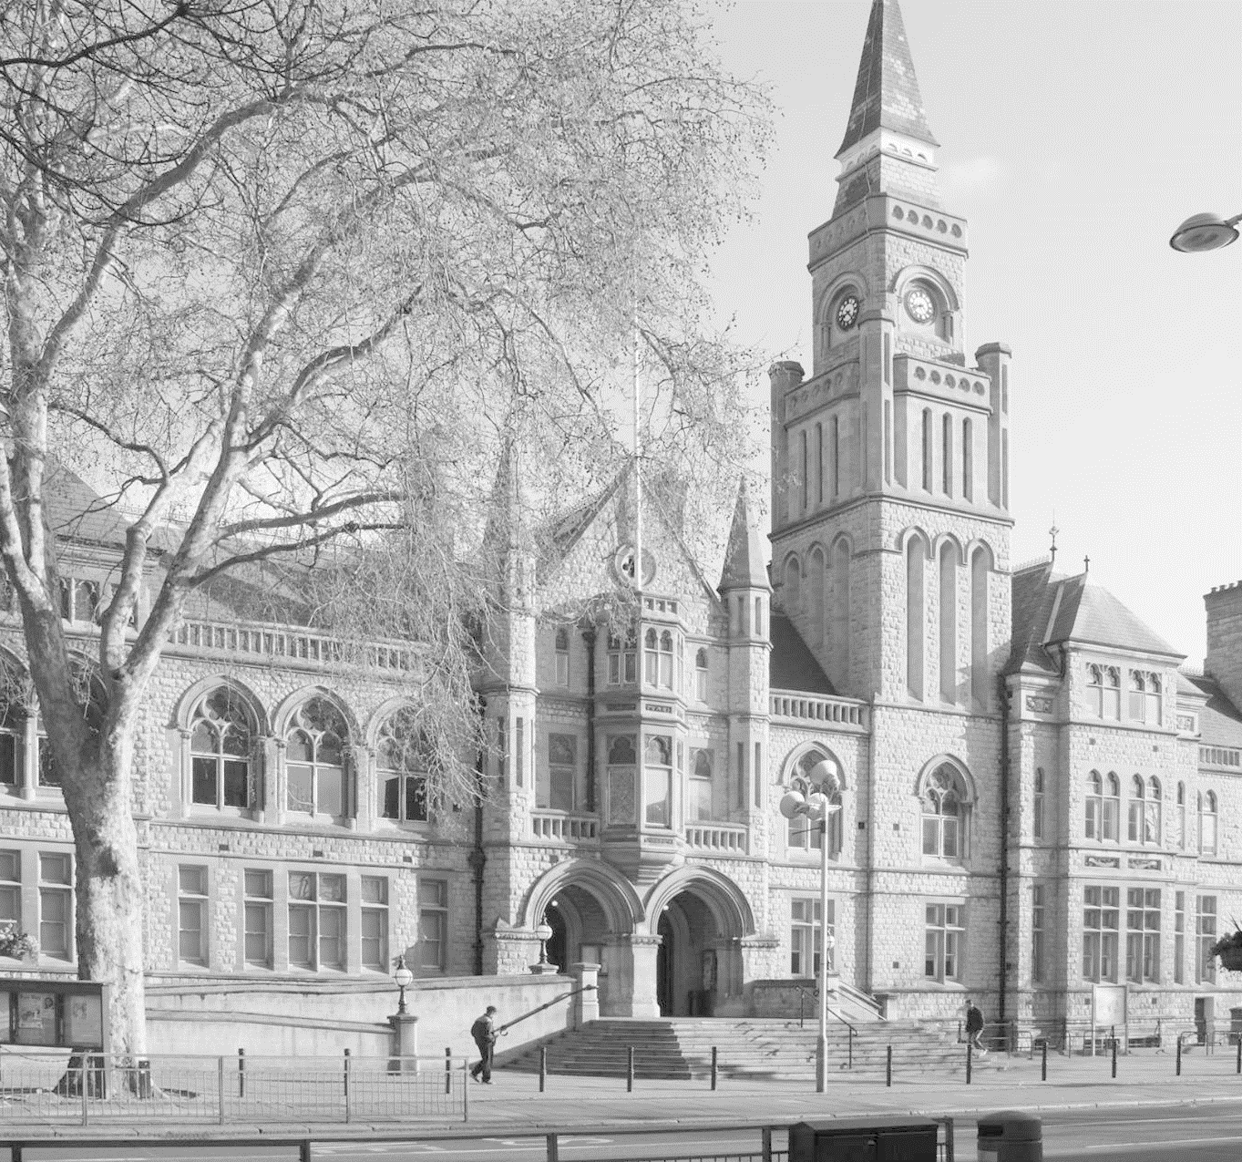
London
Redeemer Church London launched at the beginning of 2013. They are based in Ealing Borough, West London, which is home to approximately 342,000 people from 172 different nations. Redeemer Church London is committed to serving the locals. One way in which they are doing this is through their Ealing Foodbank initiative; which is now open 5 days a week across 5 locations. This has become the busiest food bank in West London. They are also hoping to launch a Mothers & Toddlers group in September.
Please join them in praying for:
1. More people to become committed followers of Christ and fully devoted radical disciples.
2. Leadership to flourish and another full-time member of staff.
3. A new venue, as theirs is being repurposed into a hotel next year.

Slide 4
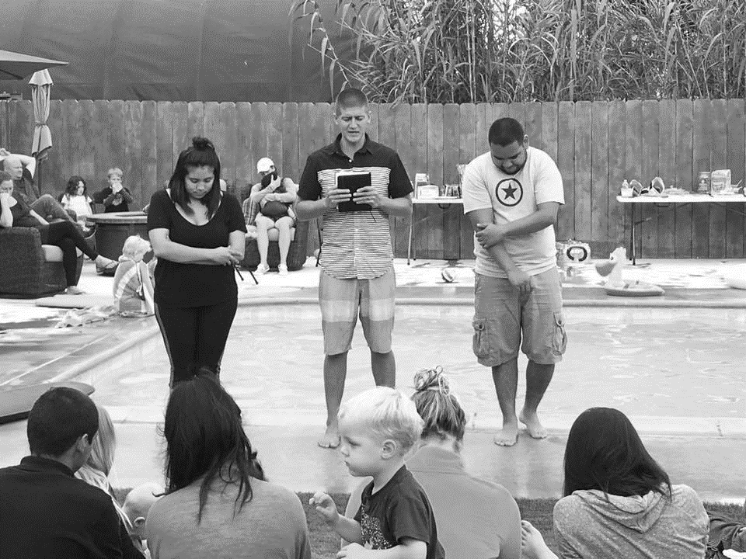
North America
Red Door is a Jesus-centered church in the city of San Diego, for the good of San Diego. They are planted in a college town near one of the biggest party schools in the U.S. - San Diego State University. Red Door's mission is to plant churches that plant churches - by making disciples that make disciples in San Diego, the West Coast and the world! They have just celebrated their 5 year anniversary.
Please join them in praying for: 1. Their first church plant taking place in Auburn, WA at the end of this year. Please pray that this team is sent well, and that God also sends and raises up men and women to fill in the gaps that will be left as they send some off their strongest leaders, volunteers and staff. They specifically need prayer for a new worship leader, as they are sending theirs to lead this plant!
2. The Larsen family and Knight family. Both Matt Larsen and Chris Knight are starting eldership training with their eldership team.
3. Many to come to faith this next school year at San Diego State University!

Slide 5
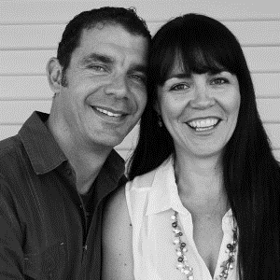
Fullerton
Fullerton is a site of Southlands Church - 22 miles outside of metropolitan Los Angeles in North Orange. Fullerton is the second "most educated" city in California, and is well known for the value it places on education and the arts. With many schools, universities, music and theater venues, the city has attracted specialty stores, coffee shops, and restaurants, and has uncharacteristically retained much of its downtown character. Unfortunately, there are many de-churched people in Fullerton.
Please join them in praying for: 1. Their mercy and justice initiatives – specifically that these lead to Gospel fruit.
2. Their community – specifically that they would not only model the gospel in the city, but proclaim it too.
3. An increased number of people choosing to commit their lives to Christ and be baptized.

Slide 6
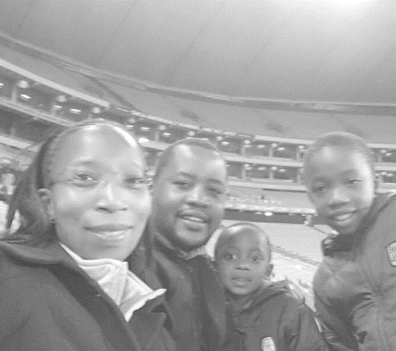
Africa:
GodFirst Tembisa is led by NK and Tumi Mahlanyane. Tembisa is a populous neighbourhood located North-East of Johannesburg city centre. As a church, they have had many opportunities to serve the community. They've contributed to the betterment of education available in the area, fed the hungry and attended to the sick and dying! However, GodFirst Tembisa believe the lasting solution to the local community's societal problems lies in the gospel of Jesus - which transforms lives from within. For this reason they make it their aim to communicate the Gospel to as many as possible.
Please join them in praying for: An increased number of people coming to Christ. They've seen many commitments
made over the years, but believe there are many more people in their community who have yet to hear the true gospel of Jesus and respond to it.
2. The launch of discipleship groups in August. Through these they are trusting God to increase levels of spiritual maturity in the church.
3. Peace in the wake of recent local government elections. There have already been reports of elections related violence in Tembisa.

Slide 7
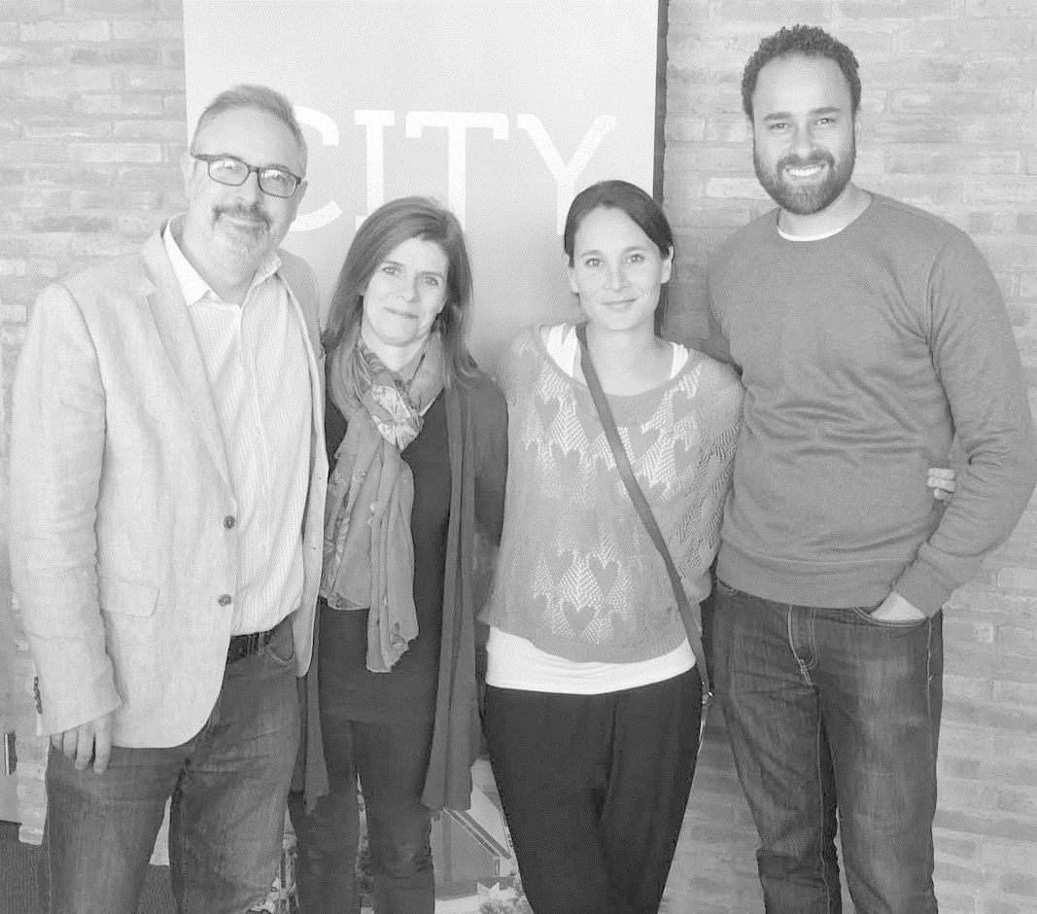
Cape Town
Jubilee Community Church are launching their first plant into Cape Town's city centre. Lex and Jo Loizides, along with Ryan and Sachi Saville, will lead the new congregation – set to meet in a beautifully renovated church building. They aim to launch with 120 committed people eager to bring the heart of God to the heart of Cape Town, on the 25th of September. The City Bowl is the epicentre of Cape Town's artistic, economic and cultural life, and Jubilee Community Church hopes to become a vibrant gospel community in the area for generations to come.
Please join them in praying for: 1. 120 committed site-planters (about 90 have given a firm commitment so far).
2. Clear, confident, personal, winsome evangelistic activity and friendship-building toward the residents in and around the city bowl.
3. New commitments to Christ from the first Sunday onward.

